Slide 1
What’s so special about November 19?
Notes:
Why is November 19 such a special day? Because it is World Toilet Day.

Slide 2
World Toilet Day!

Slide 3
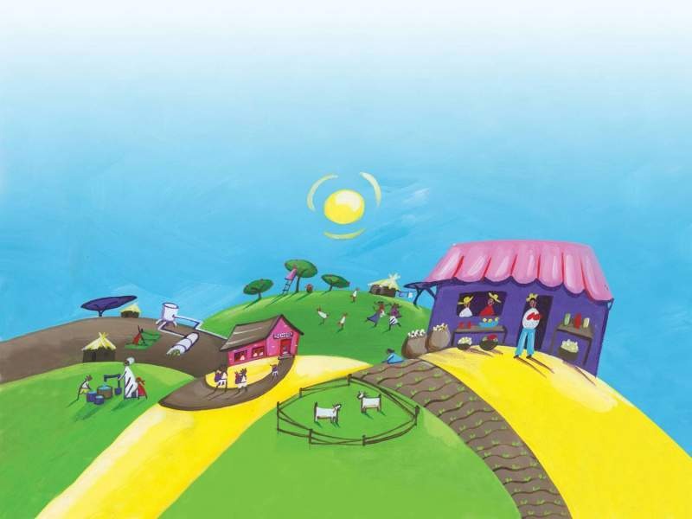
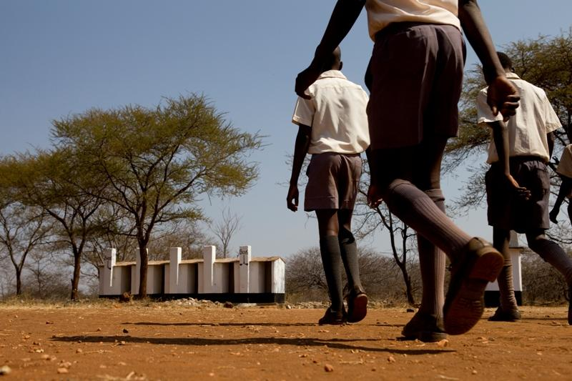
Why do we need World Toilet day?
Notes:
Raise your hand if you have a bathroom/toilet at home? Raise your hand if your mum/dad have a mobile phone? Did you know that more people own a mobile phone than toilet? How would you manage if you did not have a toilet at home? (Ask for feedback from a few children).
1 billion* people in the world do not have a toilet in their house or even outside to use. This means they have to go to the toilet in the bushes or in a field. What do you think the risks may be in doing this? (Waste can get washed away into the local rivers, it is unhygienic and can cause diseases, animals can attack you etc).
*From WHO progress on Sanitation ad Drinking Water update 2013

Slide 4

Toilets prevent disease!
Toilets save lives!
Notes:
Our toilets work so hard and are so important. If you think about your toilet, it is AMAZING! They are always working hard to save the day! We all have a superhero in our homes….
I am now going to tell you about how CAFOD (through it’s partners) have helped to transform people’s lives by supporting them to build toilets in their community!

Slide 5
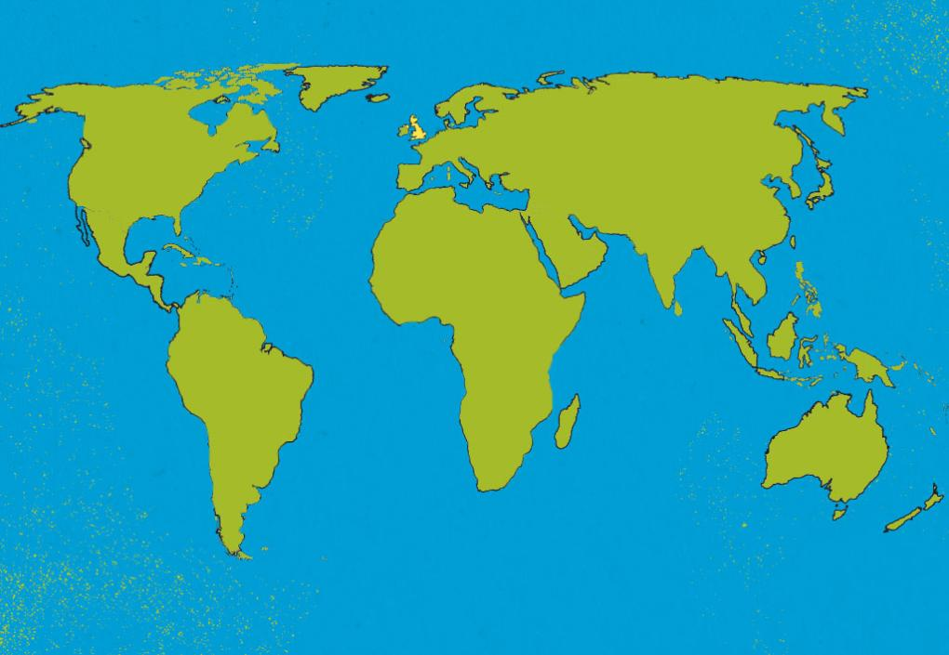

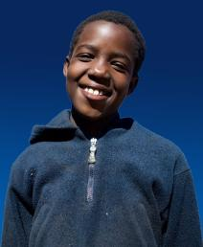
Zimbabwe
Notes:
Ten-year-old Zimisozettu, known as “Zimi”, lives in a remote village in Zimbabwe. Zimbabwe is a beautiful country in Africa. Her community faced the problem of a lack of toilets.

Slide 6
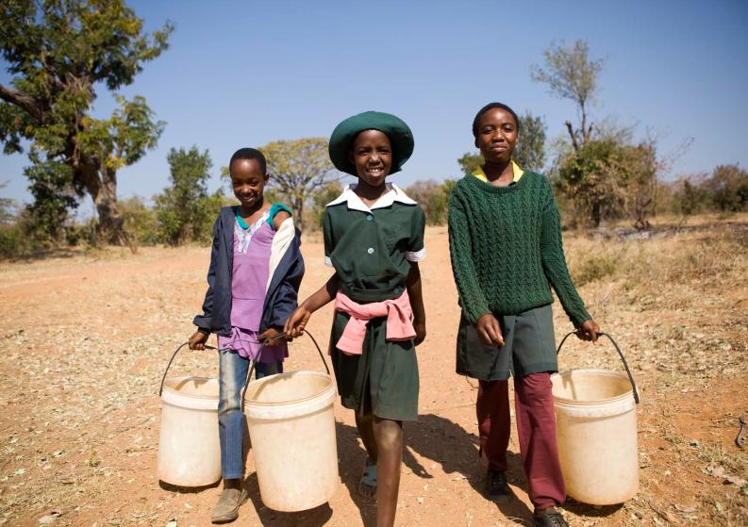

Image: Zimi
Notes:
Until recently, Zimi and her family didn’t have a toilet in their home. There were also no working toilets at Zimi’s school. That meant that Zimi had to use holes in the ground outside to go to the toilet.

Slide 7
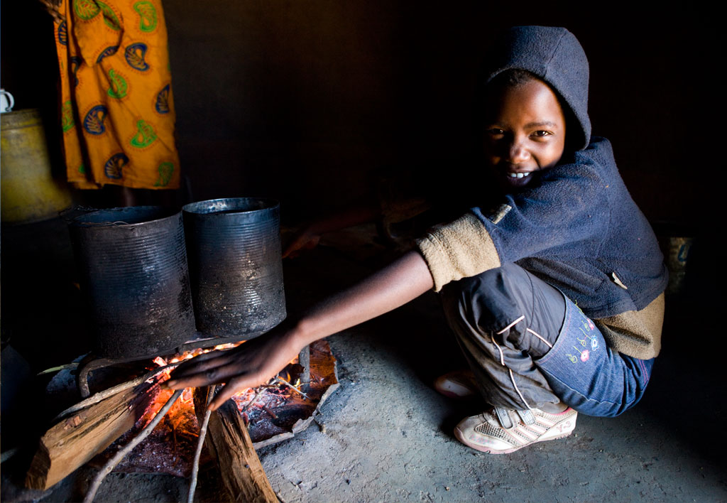
Having toilets in the school means we are more hygienic. We help out by washing the toilets and keeping them clean. It’s good having toilets and a well near the school. It makes our lives easier.
Notes:
CAFOD has now helped to build toilets in Zimi’s home and at the local schools.

Slide 8


“Having good toilets in school has improved our health. It’s rare for pupils to be off school with stomach problems these days.”
Thando, Zimbabwe
Notes:
This is Thando, he is Zimi’s cousin. Thando goes to the local secondary school.
Our partner has also built toilets in Thando’s school.

Slide 9
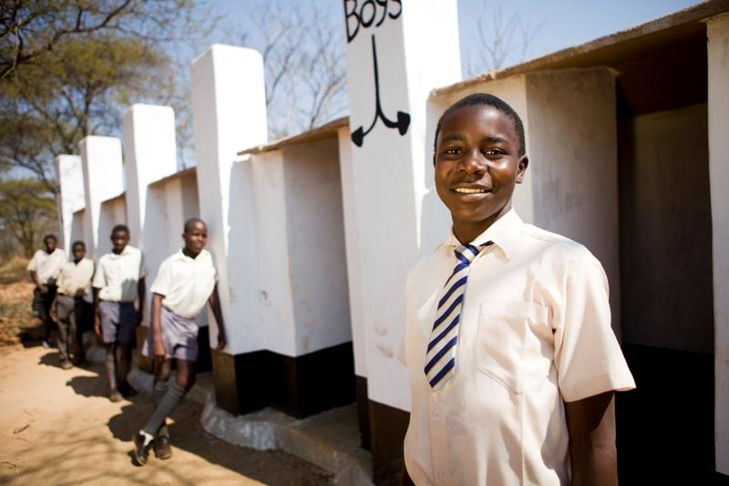
Notes:
The picture shows Thando and his friends outside their school toilets. One of Thando’s teachers says: “The law here says that every school needs a proper toilet. If CAFOD hadn’t come to help, one way or another, our school could have been forced to close. So thank you for constructing our toilets.”
CAFOD funding has built 35 toilets in the village so far.

Slide 10
Go potty for toilets!
£85 buys one community toilet!
Notes:
You can build a toilet for a community like Zimi and Thando’s! A community toilet can be bought for £85 through CAFOD world gifts. Could you raise £85 in your school to but a toilet?
Here are some fundraising ideas: sponsored swim, mufti day with blue clothes, drinks sale, walk for water, hook the ducks, dress up as your favourite superhero

Slide 11
Let us pray
Loving God,
we pray for a world of justice
where everyone has access to
a toilet and clean water.
May all our sisters and brothers throughout the world
be able to live in dignity.
We thank you God for creating us all in your image
and making us your children.
Amen
Photos: Simon Rawles
Illustrations: Linda Bronson
Notes:
cafod.org.uk/schoolsworldgifts

